Slide 1
Soft-Sensor Design for Sulphur Recovery Unit
Anshuman Gupta – 2022CHB1043
Manavaditya – 2022CHB1051

Slide 2
Description of the Process/System Details
Objective :
Develop Soft Sensors (SSs) for estimating H2S and SO2 in a Sicilian refinery's Sulfur Recovery Unit (SRU) tail stream.
● SRU Configuration:
The SRU processes MEA and SWS gas, extracting sulfur via H2S partial oxidation with air (AIR_MEA), supplemented by regulated airflow (AIR_MEA_2).
● Process Monitoring:
Currently, an online analyzer measures H2S, SO2 concentrations, and ½H2S: 2½SO2 ratio for performance monitoring and air-to-feed ratio control. SSs are essential for redundancy and fault detection during maintenance.

Slide 3
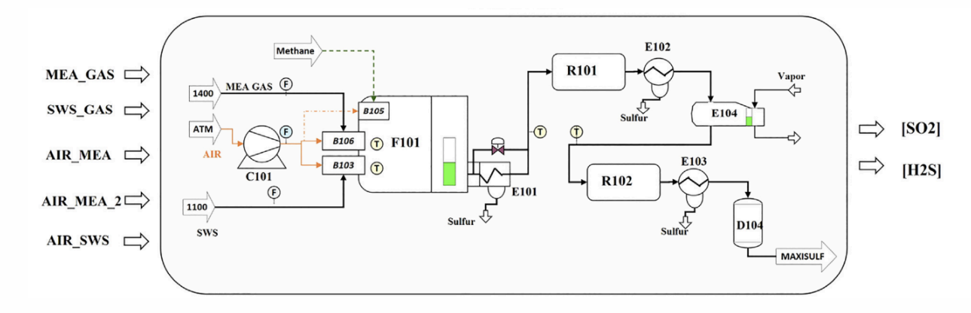
Dimensionality of the problem
There are 5 input variables and 2 output variables as depicted below

Slide 4
Algorithms Applied
Multi-Linear Regression
Lasso Regression
Polynomial regression
PCA (Principal Component Analysis) + PCR
LSTM
k-NN

Slide 5
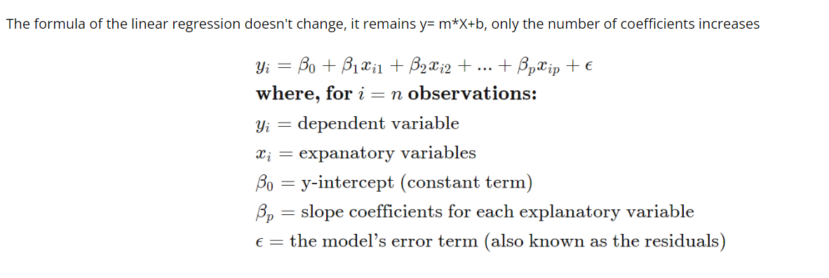
Multi-Linear Regression

Slide 6
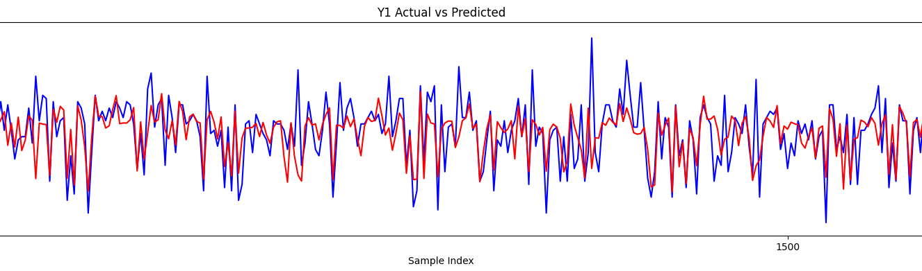
Multi-Linear Regression – Out 1
Predictive Performance | Values
Sum of squared errors (SSE) | 0.41361865245537066
R² | 0.5037888674579554
Akaike Information Criterion (AIC) | --24715.98171766948
Bayesian Information Criterion (BIC) | --24686.28948991366
Coefficients
β₀ | β₁ | β₂ | β₃ | β₄ | β₅
-0.0104704597 | 0.13687528 | 0.15691683 | 0.32220493 | 0.03659179 | 0.23094313]

Slide 7
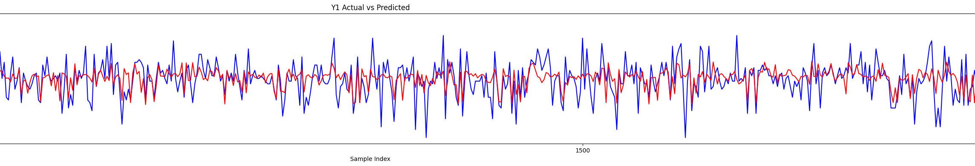
Multi-Linear Regression – Out 2
Predictive Performance | Values
Sum of squared errors (SSE) | 0.5601043573394964
R² | 0.2548955774272017
Akaike Information Criterion (AIC) | -23866.171825018384
Bayesian Information Criterion (BIC) | -23836.47959726256
Coefficients
β₀ | β₁ | β₂ | β₃ | β₄ | β₅
-0.0115011454075 | -0.3867676 | -0.18602322 | 0.73015269 | 0.40109 | 0.04611731

Slide 8
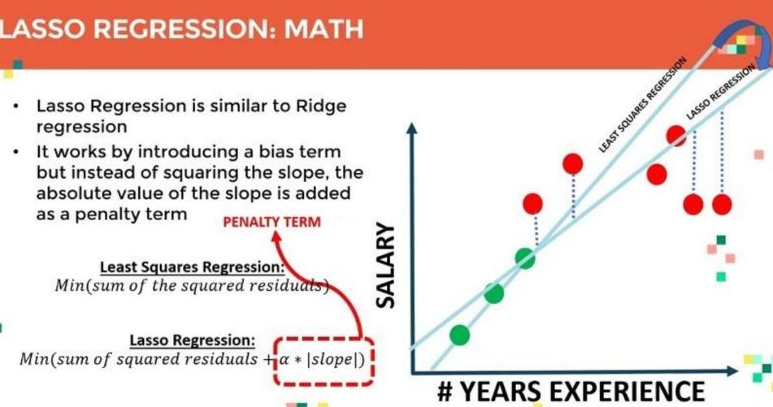
Lasso Regression

Slide 9
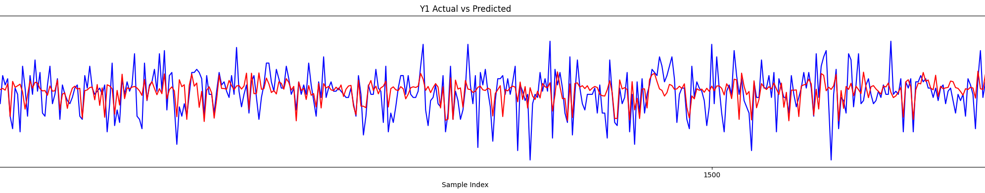
Lasso Regression – Out 1
Predictive Performance | Values
Sum of squared errors (SSE) | 0.537005716614197
R² | 0.35576354392906684
Akaike Information Criterion (AIC) | -23984.218428916567
Bayesian Information Criterion (BIC) | -23954.526201160745

Slide 10
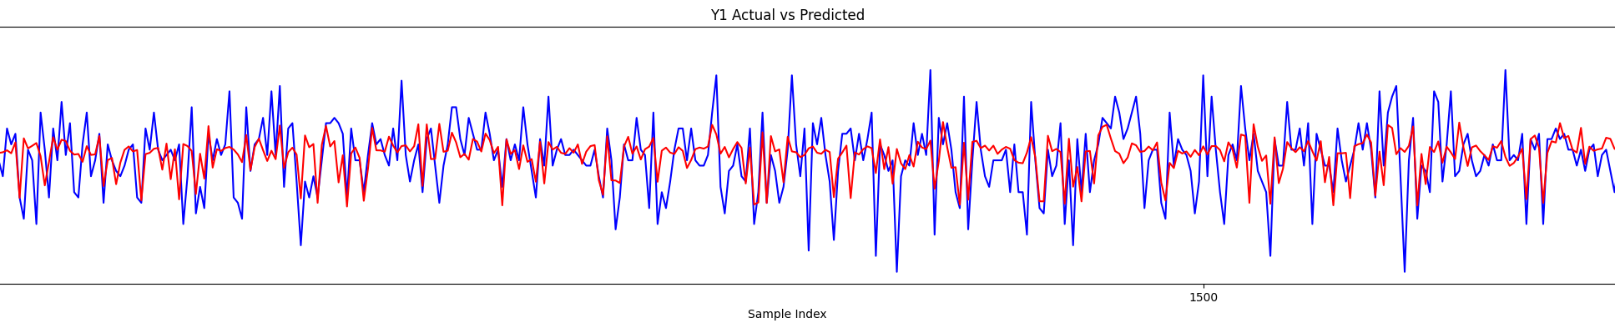
Lasso Regression – Out 2
Predictive Performance | Values
Sum of squared errors (SSE) | 0.5601041200034349
R² | 0.2548958931543456
Akaike Information Criterion (AIC) | -23866.173012749052
Bayesian Information Criterion (BIC) | -23836.48078499323

Slide 11
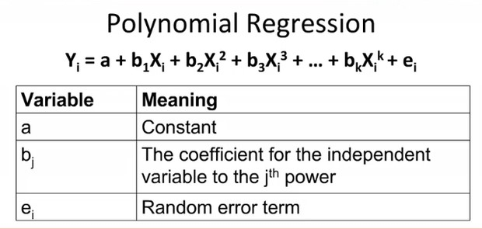
Polynomial Regression

Slide 12
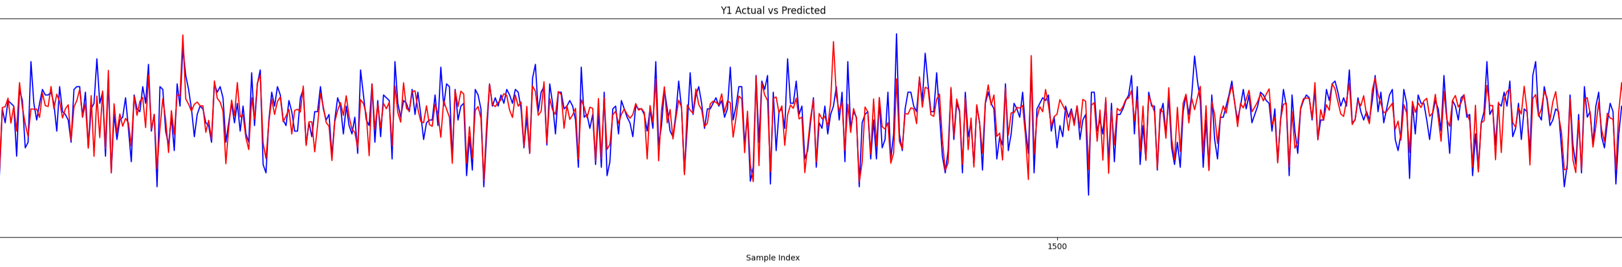
Polynomial Regression – Out 1 @ n=6
Predictive Performance | Values
Sum of squared errors (SSE) | 0.26149008578646
R² | 0.68629487368048
Akaike Information Criterion (AIC) | -26001.291902005
Bayesian Information Criterion (BIC) | -25971.599674249

Slide 13
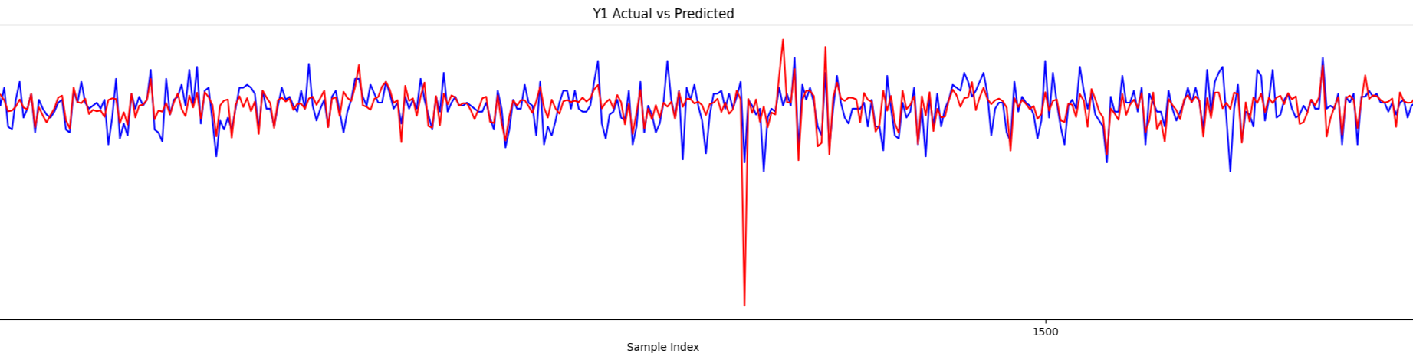
Polynomial Regression – Out 2 @ n=6
Predictive Performance | Values
Sum of squared errors (SSE) | 0.43445834838273
R² | 0.42204192386342
Akaike Information Criterion (AIC) | --24578.198405237
Bayesian Information Criterion (BIC) | -24548.50617748

Slide 14
N | R2 OUT 1 | R2 OUT 2
2 | 0.53 | 0.28
3 | 0.58 | 0.319
4 | 0.62 | 0.35
5 | 0.66 | 0.41
6 | 0.68 | 0.42
7 | 0.66 | 0.36
8 | 0.28 | Absurd

Slide 15
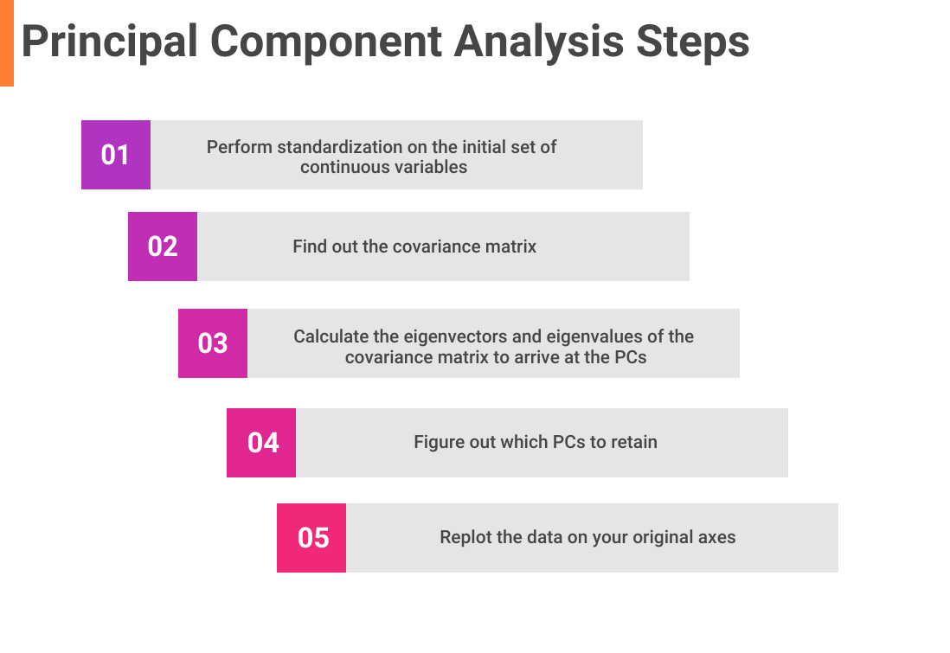
PCA

Slide 16
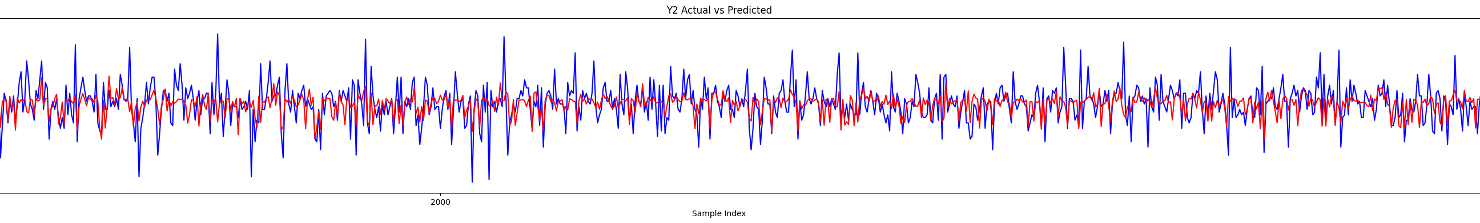
PCA + PCR Out 1
Predictive Performance | Values
Mean of squared errors (MSE) | 0.68961238440764
R² | 0.2261019590707
Akaike Information Criterion (AIC) | -16082.915851825
Bayesian Information Criterion (BIC) | -16065.033834000

Slide 17
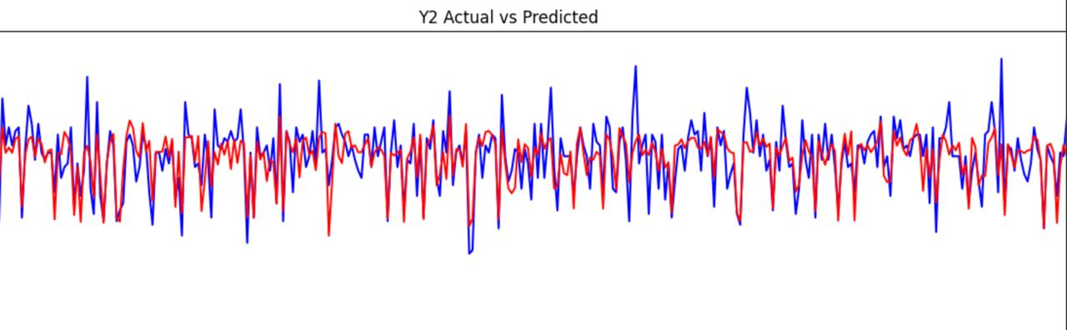
PCA + PCR Out 2
Predictive Performance | Values
Mean of squared errors (SSE) | 0.3401
R² | 0.5926
Akaike Information Criterion (AIC) | -27673.961
Bayesian Information Criterion (BIC) | -27629.553

Slide 18
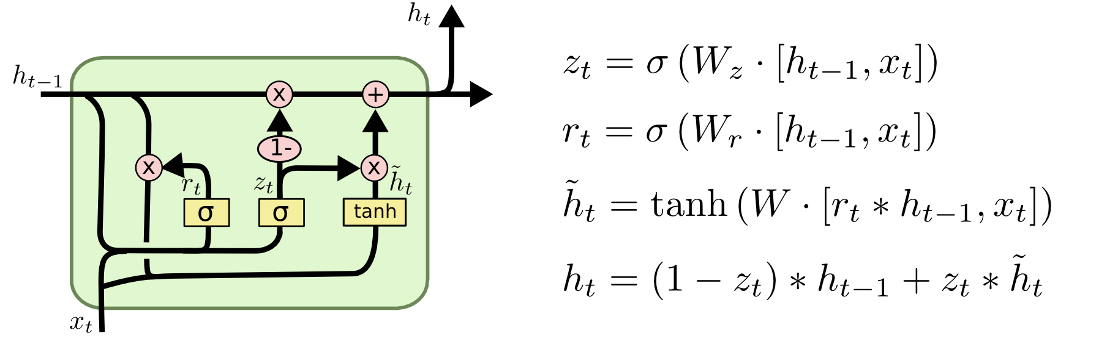
LSTM

Slide 19
LSTM – Out 1
Number Of Epocs | R²
250 | 0.542703
500 | 0.567545
750 | 0.592752
1000 | 0.599645

Slide 20
LSTM – Out 2
Number Of Epocs | R²
250 | 0.528324
500 | 0.556115
750 | 0.580552
1000 | 0.586577

Slide 21
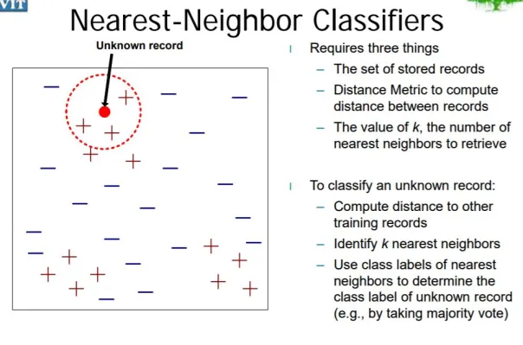
K – NEAREST NEIGHBOURS

Slide 22
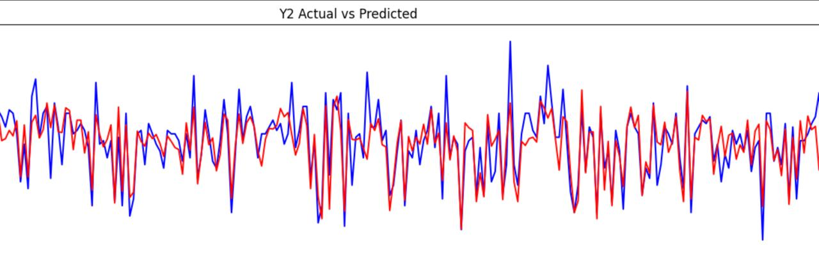
PCA Based Linear After k-NN: Out 1
Predictive Performance | Values
Mean of squared errors (MSE) | 0.2458
R² | 0.7051
Akaike Information Criterion (AIC) | -18226.902
Bayesian Information Criterion (BIC) | -18206.087

Slide 23
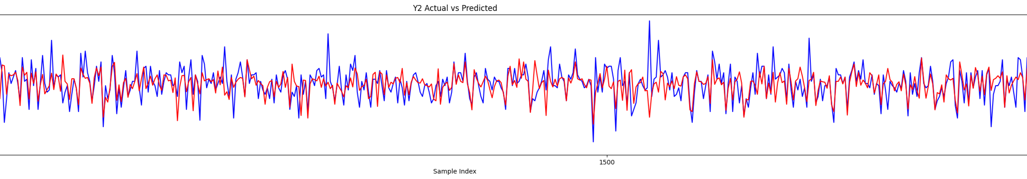
PCA Based Linear After k-NN: Out 2
Predictive Performance | Values
Mean of squared errors (MSE) | 0.61206151899319
R² | 0.32312657344341
Akaike Information Criterion (AIC) | -16082.915851825
Bayesian Information Criterion (BIC) | -16065.033834000

Slide 24
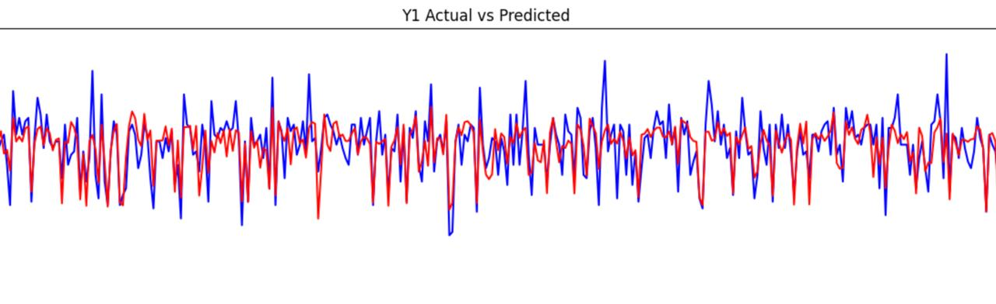
Polynomial after k-NN: Out 1
Predictive Performance | Values
Mean of squared errors (MSE) | 0.2551
R² | 0.694
Akaike Information Criterion (AIC) | -18120.245
Bayesian Information Criterion (BIC) | -18102.429

Slide 25
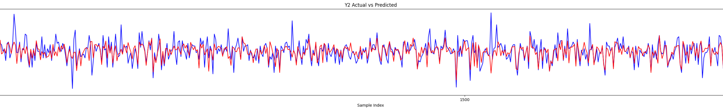
Polynomial after k-NN: Out 2
Predictive Performance | Values
Mean of squared errors (MSE) | 0.53774660845421
R² | 0.4053107764684
Akaike Information Criterion (AIC) | -16453.906189049
Bayesian Information Criterion (BIC) | -16436.024171224

Slide 26
Conclusion
Model | R2-Out 1 | R2-Out 2
Multi Linear Regression | 0.51 | 0.25
Lasso Regression | 0.35 | 0.25
Polynomial Regression | 0.68 | 0.42
PCA + PCR | 0.22 | 0.57
LSTM | 0.59 | 0.58
PCA based Linear after k-NN | 0.71 | 0.32
Polynomial after k-NN | 0.69 | 0.4

